Slide 1
Recurrent Neural Networks
Tim Smith, PhD

Slide 2
Recurrent Neural Networks (RNN)
Regular neural networks analyze “cross-sectional” data
No “time” dimension
RNNs can look at both:
Current state (i.e., cross-section)
Recent past
Advantage: information can “persist” in the neural network
Similar to “watching a movie”

Slide 3
Recurrent Neural Networks (RNN)
Helps analyze "time-series" data sets
Can handle sequences of data!
Example applications:
Stock prices?!
What you'll type next
Car trajectory in self-driving
Machine translation
Speech-to-text (i.e., Alexa, Google Assistant)
Audio and songs

Slide 4
Note: watching a movie!
How would you organize the data set?
Inputs: plot highlights at certain “time steps”
Target: “feel good movie” or not
Movie ID | T.S.1 | T.S.2 | … | … | … | T.S.(N) | Target
1 | 0.31 | 0.44 | … | … | … | … | 1
2 | 1.34 | 1.74 | … | … | … | … | 0
… | … | … | … | … | … | … | …
… | … | … | … | … | … | … | …
(M) | 0.65 | 1.55 | … | … | … | … | 0

Slide 5
Note: watching a movie!
I SHOULD process the values “sequentially” (not “cross-sectionally”)
Example, consider the first movie:
Movie ID | T.S.1 | T.S.2 | … | … | … | T.S.(N) | Target
1 | 0.31 | 0.44 | … | … | … | … | 1
Cross-sectional NN
Sequential NN
Input
Hidden
Output
Input
Hidden
Output
T.S.3 = …
T.S.1 = 0.31
T.S.2 = 0.44
…
T.S.1 = 0.31
T.S.(N) = …

Slide 6
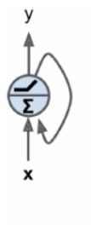
Recurrent Neurons
We also need a mechanism to “remember past values” in a sequence
Neurons have connections from past (i.e., previous) observations
Neurons receive an input, generate an output. This output is sent back (and processed together with next input)
Recurrent neural networks are “feedforward” networks with backward connections!!!

Slide 7
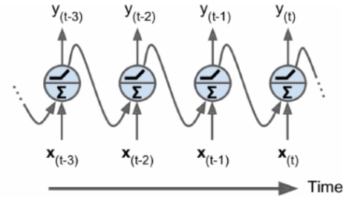
Recurrent Neurons
“Unroll the network through time”:
All four neurons are the same neuron "unrolled through time"

Slide 8
Recurrent Neurons
Temp readings: (each row represents one day)
[[78, 80, 84, 87, 90, …] [74, 75, 76, 77, 78, …
79.4
81.1
84.3
0
All four neurons are the same neuron "unrolled through time"
79.4
81.1
84.3
78
80
84
87

Slide 9
Recurrent Neurons
If there are multiple neurons in the hidden layer:
y₀₁
y₀₃
y₁₁
y₁₂
y₁₃
y₀₂
etc.
w
w
w
w
w
w
w
w
w
x₀
x₁
y₀₃
y₀₁
y₀₂
T₀
T₁

Slide 10
Memory Cells
A neuron has a “memory” (so, we call it a “memory cell”)
A neuron’s one "input" comes from the previous time step
A single recurrent neuron can learn about 10 time-steps
More advanced recurrent neurons can learn longer

Slide 11
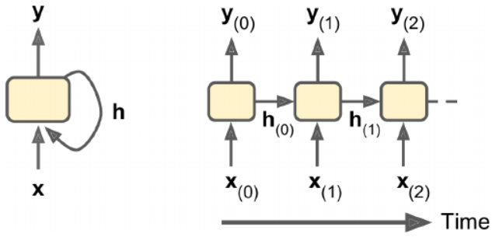
Memory Cells
A cell's state is called h (for hidden)
y (output) is a function of h_{t-1} (previous state) and x_{t}

Slide 12
Let’s say we have stock prices…

Slide 13
Activation
function
Input
W₁
b₁
W₂
b₂
Output
t₁
100
110
108
108
113.4
112
t₂
x 1.1
- 2.0
x 1.05
- 1.4
112

Slide 14
Activation
function
Input
W₁
b₁
W₂
b₂
Output
t₂
123.2
101.34
101.34
106.41
105
112
x 1.1
- 2.0
x 1.05
- 1.4
105
t₃
-19.86
W₃
108
x -0.184

Slide 15
Activation
function
Input
W₁
b₁
W₂
b₂
Output
t₂
115.5
96.85
96.85
101.7
100.3
105
x 1.1
- 2.0
x 1.05
- 1.4
100.3
t₃
-18.65
W₃
101.34
x -0.184

Slide 16
Activation
function
Input
W₁
b₁
W₂
b₂
Output
t₁
100
110
108
108
113.4
112
t₂
x 1.1
- 2.0
x 1.05
- 1.4
112
W₃
x -0.184
108
-19.86
Activation
function
Input
W₁
b₁
W₂
b₂
Output
t₂
101.34
101.34
106.41
105
112
x 1.1
- 2.0
x 1.05
- 1.4
105
t₃
123.2
W₃
101.34
x -0.184
-18.65
Activation
function
Input
W₁
b₁
W₂
b₂
Output
t₃
96.85
96.85
101.7
100.3
105
x 1.1
- 2.0
x 1.05
- 1.4
100.3
t₄
115.5
Etc.

Slide 17
Activation
function
Input
W₁
b₁
W₂
b₂
Output
t₁
100
110
108
108
113.4
112
t₂
Cost = 0
x 1.1
- 2.0
x 1.05
- 1.4
112
W₃
x -0.184
108
-19.86
Activation
function
Input
W₁
b₁
W₂
b₂
Output
t₂
101.34
101.34
106.41
105
112
x 1.1
- 2.0
x 1.05
- 1.4
105
t₃
Cost = 0
123.2
W₃
101.34
x -0.184
-18.65
Activation
function
Input
W₁
b₁
W₂
b₂
Output
t₃
96.85
96.85
101.7
100.3
105
x 1.1
- 2.0
x 1.05
- 1.4
100.3
t₄
Cost = 19.7
115.5
We can calculate ‘how good’ our RNN is by calculating total cost.
Total Cost is 19.7

Slide 18
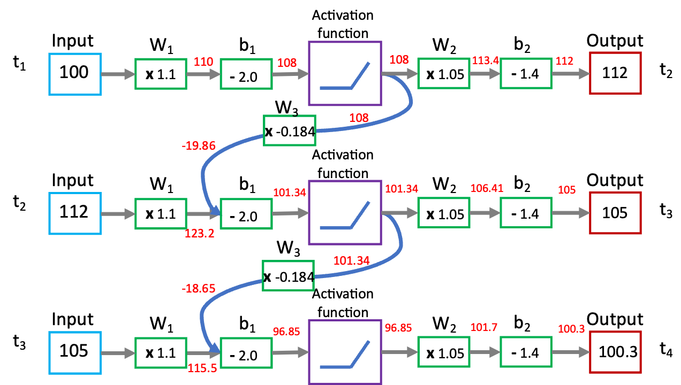
Cost = 0
Cost = 0
Cost = 19.7
Backpropagation Through Time (BPTT:)
Perform the first pass through the unrolled network
Evaluate the output sequence using a cost function
Back propagate the gradients through the unrolled network
Update parameters
repeat…
Total Cost is 19.7

Slide 19
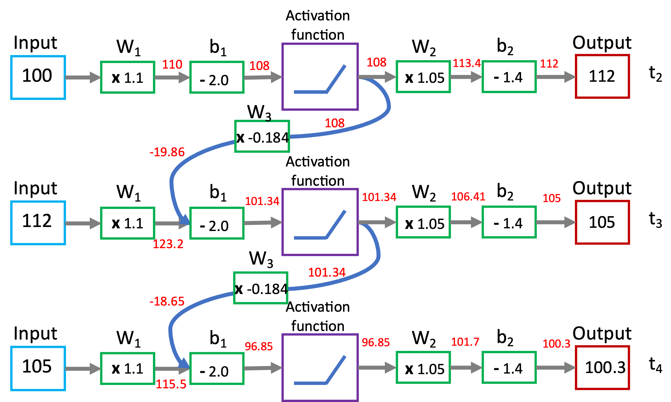
t₁
t₂
t₂
t₂
t₃
t₃
t₃
t₄
Y₁
Y₂
Y₂
We often represent RNNs in more simplified forms…
X₁
X₂
X₃

Slide 20
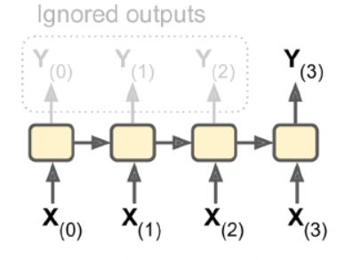
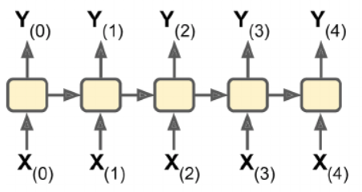
Inputs and Outputs
There are different types of RNNs based on inputs and outputs
1) Predict a single value
Input: a sequence of values
Output: one value
E.g., feed a sequence of words, predict sentiment
2) Predict a sequence
Input: a sequence of values
Output: a sequence of values
E.g., feed stock prices, predict stock prices shifted by one day

Slide 21
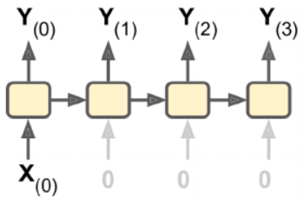
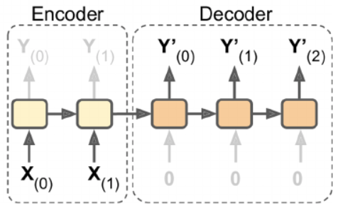
Inputs and Outputs
3) Predict a sequence based on a single value
Input: one value
Output: sequence of values
E.g., feed an image, predict its caption
4) Predict a sequence based on a sequence
Input: sequence of values
Output: sequence of values
E.g., translation (the whole statement is used to generate Y' values (translated statement))

Slide 22
Forecasting a Time Series
Two kinds of time series:
Univariate (a single variable per time step)
Average temperature per day for 30 days
Multivariate (two or more variables per time step)
Average temperature per day, and average humidity per day for 30 days
Goal: predict next value (either a single value or sequence)
RNNs can perform both tasks

Slide 23
Sequence to sequence example:
Input: (daily temp values at 8am, 10am, 12pm, 2pm, 4pm)
[[78, 80, 84, 87, 90] [74, 75, 76, 77, 78] […]]
Target: (daily temp values at 6pm, 8pm)
[[88, 87] [77, 77] […]]

Slide 24
Sequence to sequence example
Input: (sliding window: 8am, 10am, 12pm, 2pm, 4pm) [[78, 80, 84, 87, 90]
[[78, 80] [80, 84] [84, 87] […]]
Target: (sliding window)
[[84, 87] [87, 90] […]]
You can ignore the intermediate predictions and focus on last 2 only (6pm, 8pm)
Tricky to do:
Requires to re-transform the training and target values
Requires TimeDistributed() wrapper for Dense() if the last layer is dense

Slide 25
Sequence to sequence example
Input: (sliding window: 8am, 10am, 12pm, 2pm, 4pm) [[78, 80, 84, 87, 90]
[[78, 80] [80, 84] [84, 87] […]]
Target: (sliding window)
[[84, 87] [87, 90] […]]
You can ignore the intermediate predictions and focus on last 2 only (6pm, 8pm)
Tricky to do:
Requires to re-transform the training and target values
Requires TimeDistributed() wrapper for Dense() if the last layer is dense

Slide 26
Sequence to sequence example
Input: (sliding window: 8am, 10am, 12pm, 2pm, 4pm) [[78, 80, 84, 87, 90]
[[78, 80] [80, 84] [84, 87] […]]
Target: (sliding window)
[[84, 87] [87, 90] […]]
You can ignore the intermediate predictions and focus on last 2 only (6pm, 8pm)
Tricky to do:
Requires to re-transform the training and target values
Requires TimeDistributed() wrapper for Dense() if the last layer is dense

Slide 27
Sequence to single value (scalar)
Predict one value only.
Input: (daily temp values at 8am, 10am, 12pm, 2pm, 4pm)
[[78, 80, 84, 87, 90] [74, 75, 76, 77, 78] […]]
Target: (daily temp values at 6pm)
[[88] [77] […]]

Slide 28
Sequence to scalar
WHAT IF YOU HAVE UNEQUAL LENGTH SEQUENCES???
Input: (daily temp values)
[[78, 80, 84, 87, 90] [74, 75, 76, 77] […]]
Target: (daily temp values at 6pm)
[[88] [77] […]]
ZERO–PADDING
[[78, 80, 84, 87, 90] [74, 75, 76, 77, 0] […]]
How do you account for zero-padding: at the input layer
model = tf.keras.models.Sequential([
tf.keras.layers.Masking(mask_value=0, input_shape=[n_steps, n_inputs]),
tf.keras.layers.LSTM(20),
(etc.)

Slide 29
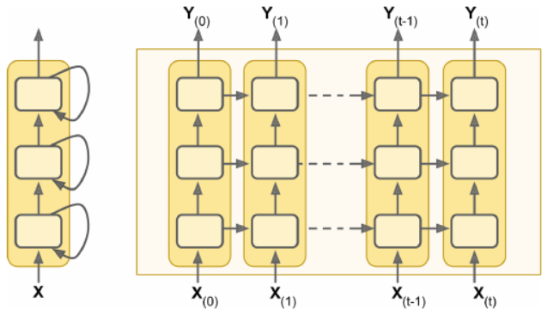
Deep RNN
Stack multiple layers

Slide 30
Issues with RNNs
Suffer from vanishing/exploding gradients (so are unstable!)
Use:
Parameter initialization
Faster optimizers
Dropout layer
Do not use:
Non-saturating activation functions (ReLu) – make things worse
Batch normalization – doesn’t work
Take a very long time to train!
Use shorter input sequences (But, what if you lose the pattern?)
Memory of the first inputs fades away
A long RNN contains no trace of first inputs

Slide 31

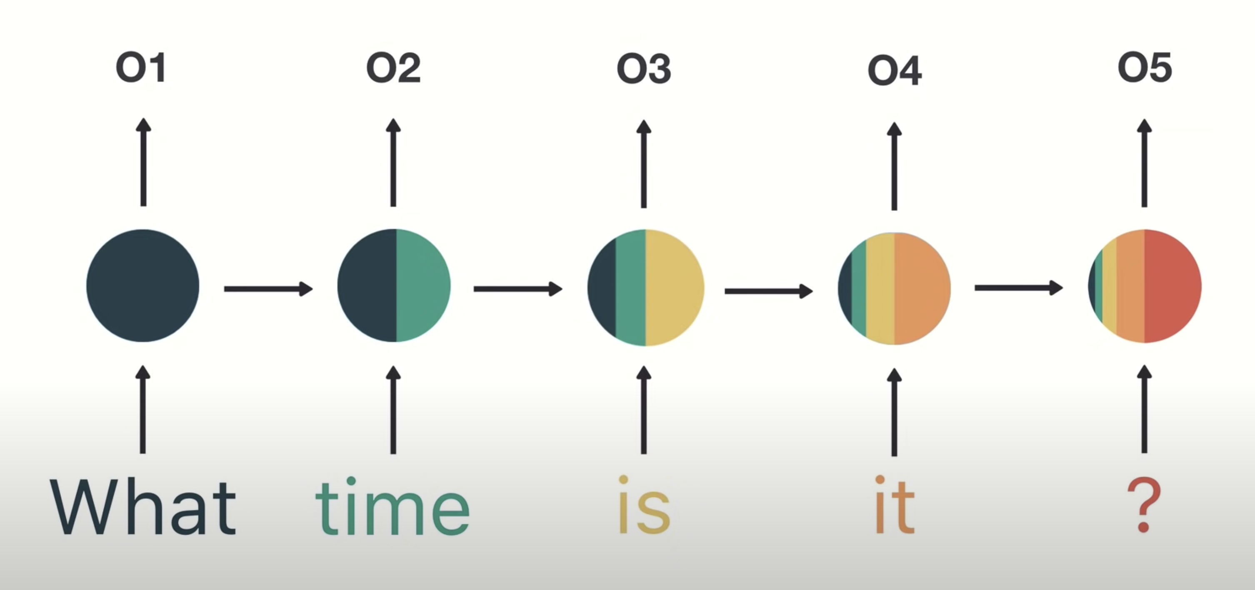
Short-term memory
In regular RNN, memory degrades quickly. The earlier portion of a sequence has less of an effect on the outcome the more memory cells there are…

Slide 32
LSTM Cells
Long Short-Term Memory cells
Remember the first inputs!
Can detect long-term dependencies
Forget gates remove irrelevant information from "long-term" state
Input gates add new memories to the long-term state

Slide 33
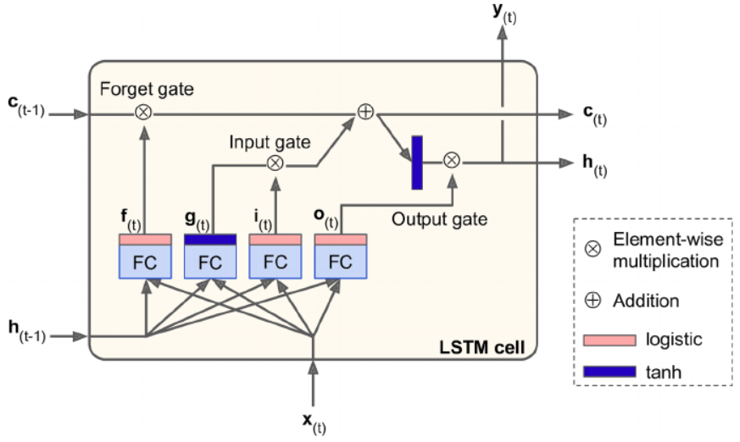
LSTM Cells
Controls what to forget from memory
Controls what to add to memory
Controls what to output for short-term
Long-term state
Logistic outputs either 1 or 0. Since multiplication, it either generates 1 or 0, which controls the gates (open, vs. close)
Short-term state
This is the basic cell we saw in RNN
FC: fully connected layer

Slide 34
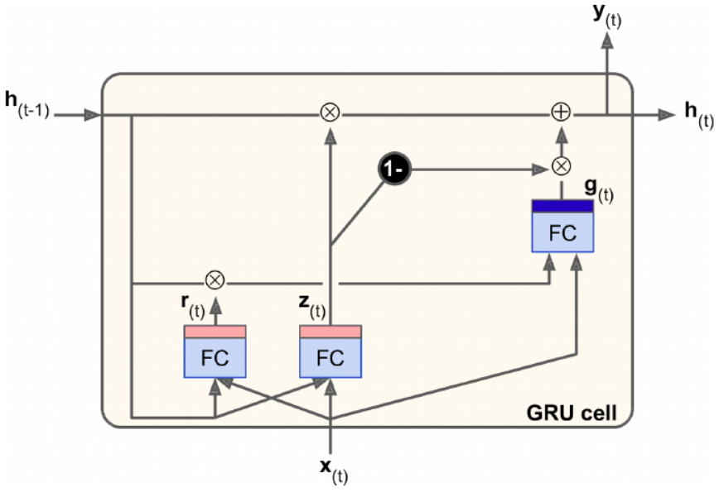
GRU Cells
Gated Recurrent Unit
A variant of LSTM cell
Much simpler than LSTM, but performs as well
Forget gate closes the input gate (can't add anything new without removing memory)

Slide 35
Convolution Layer (1D)
LSTM and GRU cells are still limited:
Have a relatively short-term memory
Have a hard time learning long-term patterns
Take a long time to process
Solution: Conv1D layer
Similar to image processing
Convolution layer on a single dimension (which is the sequence)

Slide 36
Convolution Layer (1D)
Uses a kernel so extract information from a sequence
Move (by stride value)
kernel
1 | 2 | 3 | 5 | 8 | 13 | 21 | 34 | … | …
Extract value

Slide 37
Convolution Layer (1D)
Use more than one kernel
Each kernel learns a pattern from a short sequence
As a result, reduce the sequence to a shorter sequence with learned patterns
Final step: feed this short sequence to a LSTM/GRU layer (to detect the overall pattern)

Slide 38
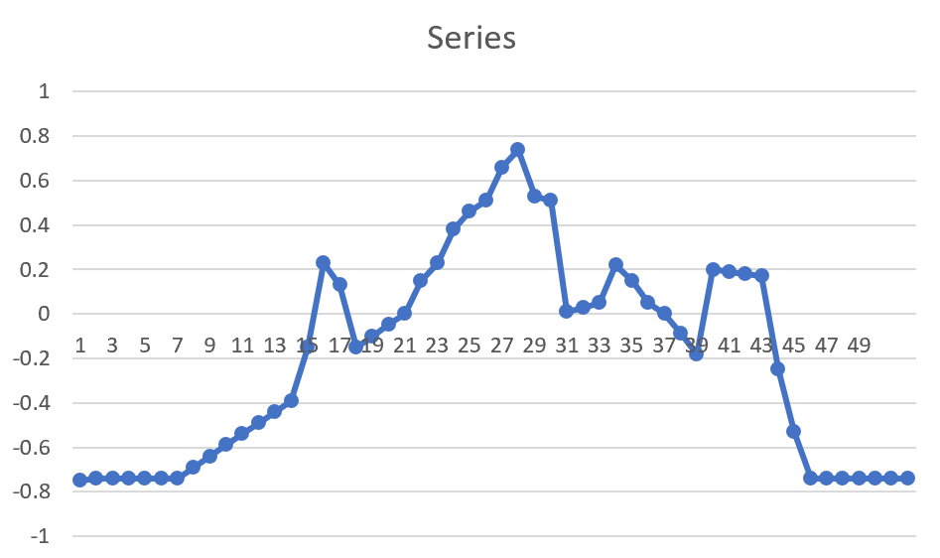
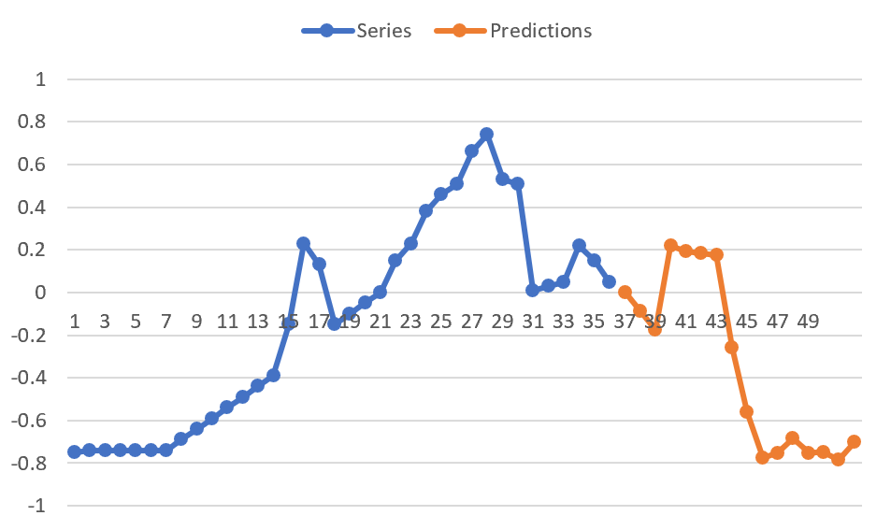
How Can We Use RNNs?
Time Series Prediction

Slide 39
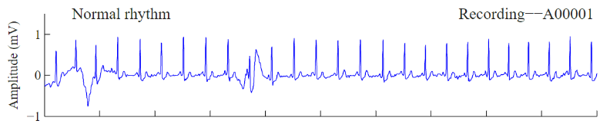
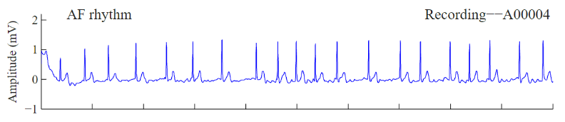
How Can We Use RNNs?
Sequence classification (e.g., Atrial Fibrillation (AF))
INPUT | TARGET
 | Normal
 | AF
(etc.) | (etc.)
(etc.) | (etc.)

Slide 40
How Can We Use RNNs?
Natural Language Processing (NLP):
Auto summarization
Predicting the next word/phrase
Parsing
Sentiment analysis
Translation

Slide 41
Summary
RNNs can do time-series and sequence analysis!
Needs a new way of thinking about data prep. and data analysis

